Slide 1

2200520100024@ietlucknow.ac.in

Slide 2
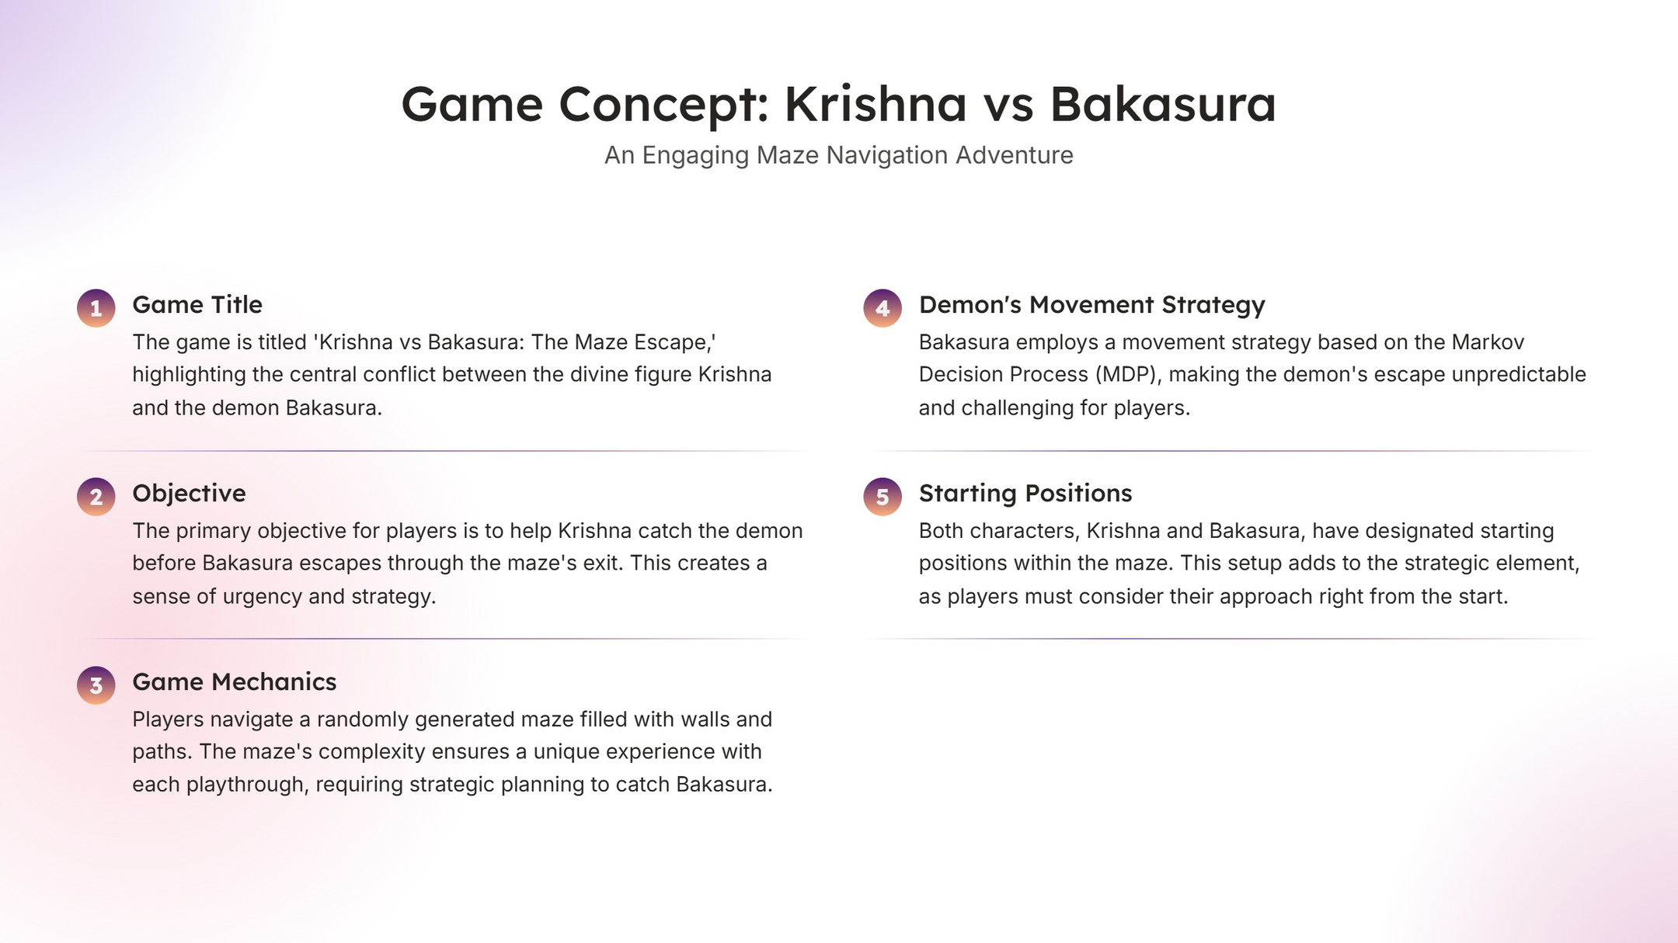

Slide 3

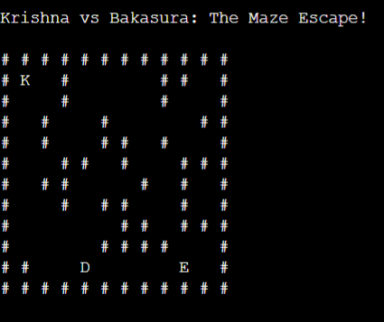

Slide 4
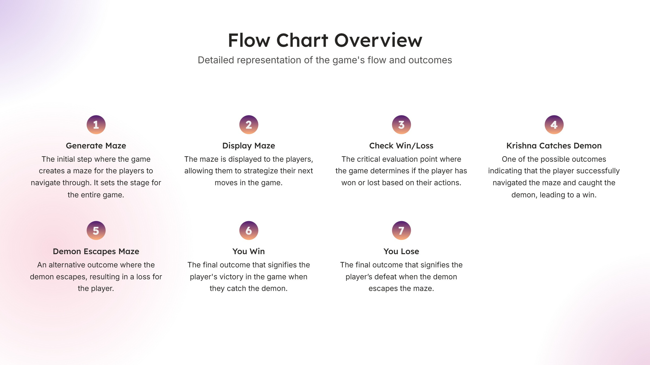


Slide 5
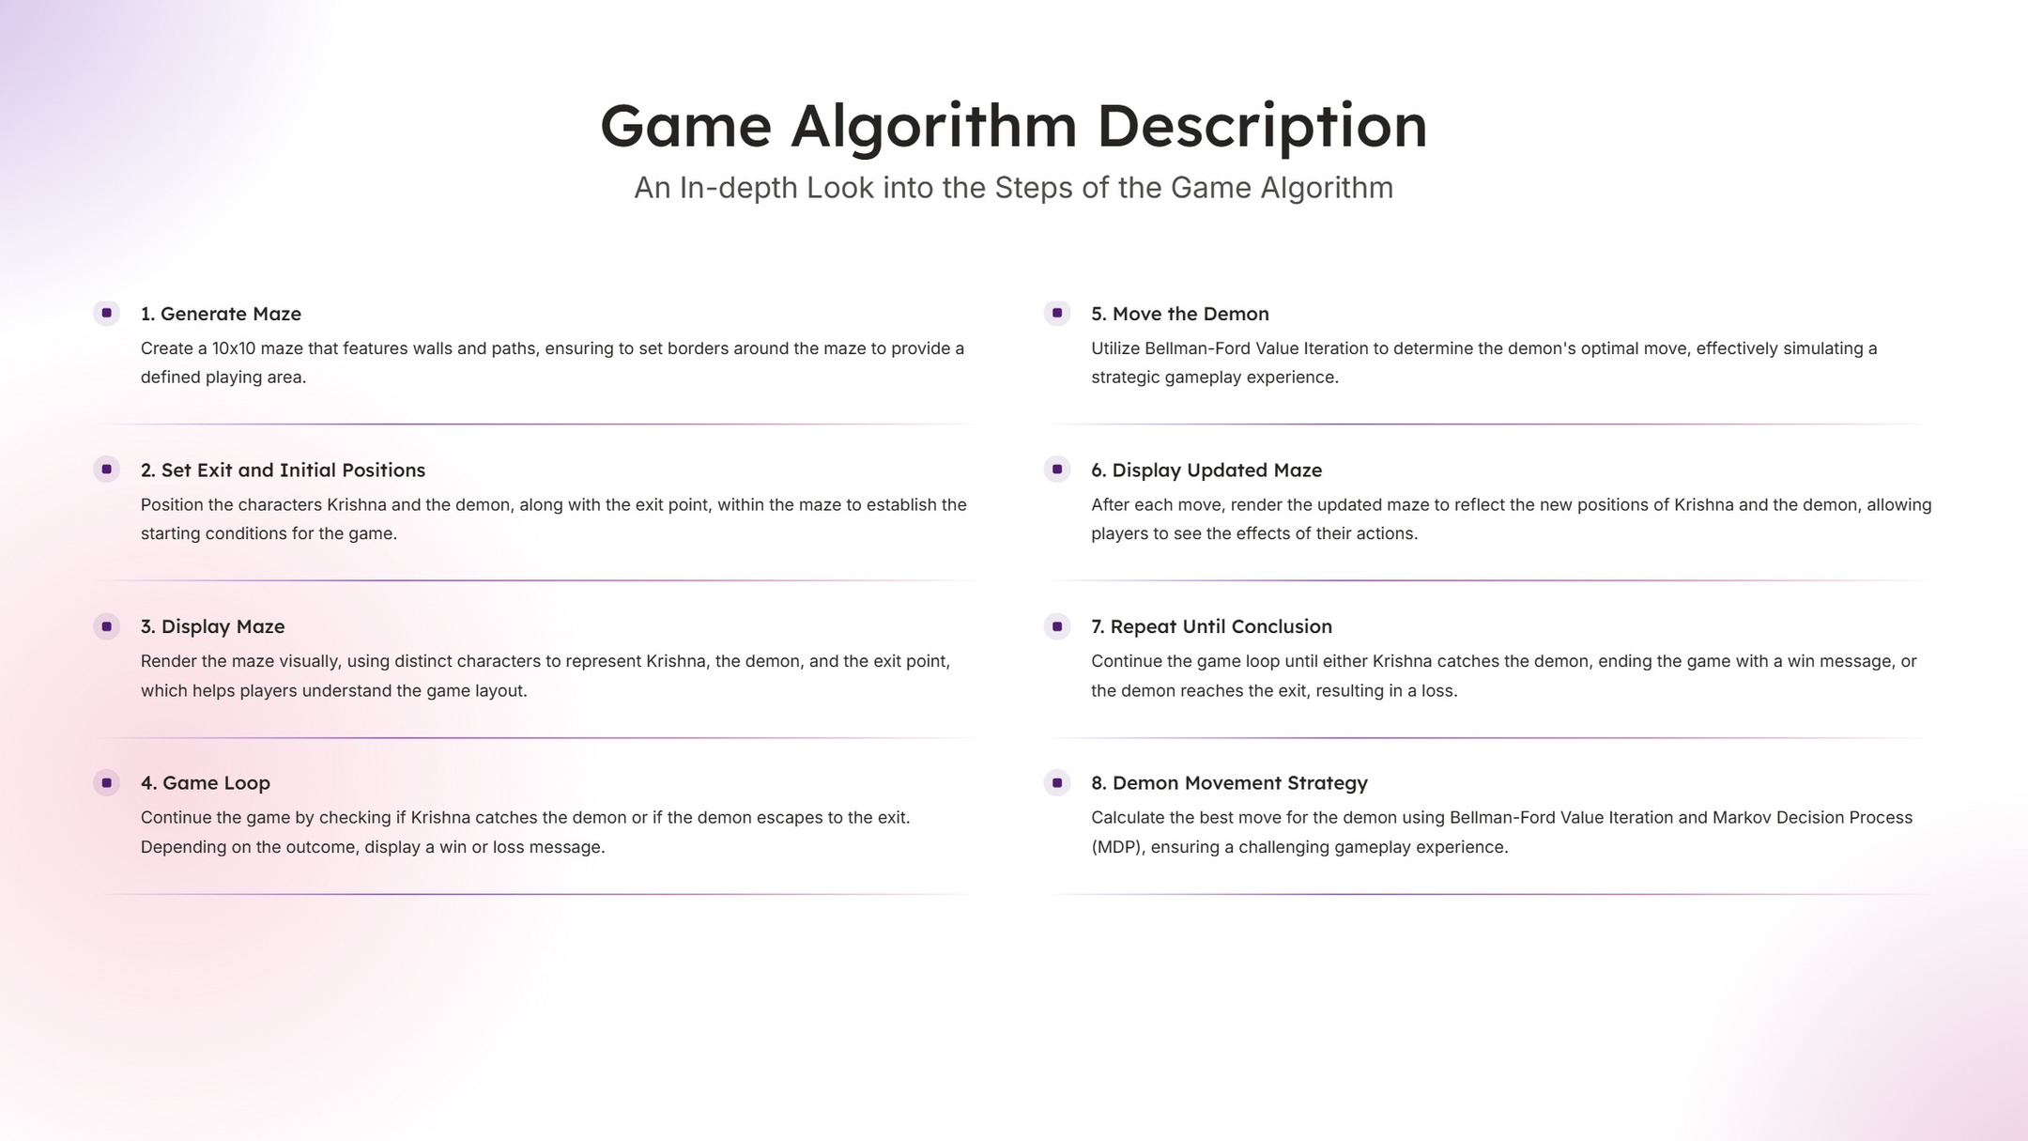

Slide 6


Slide 7
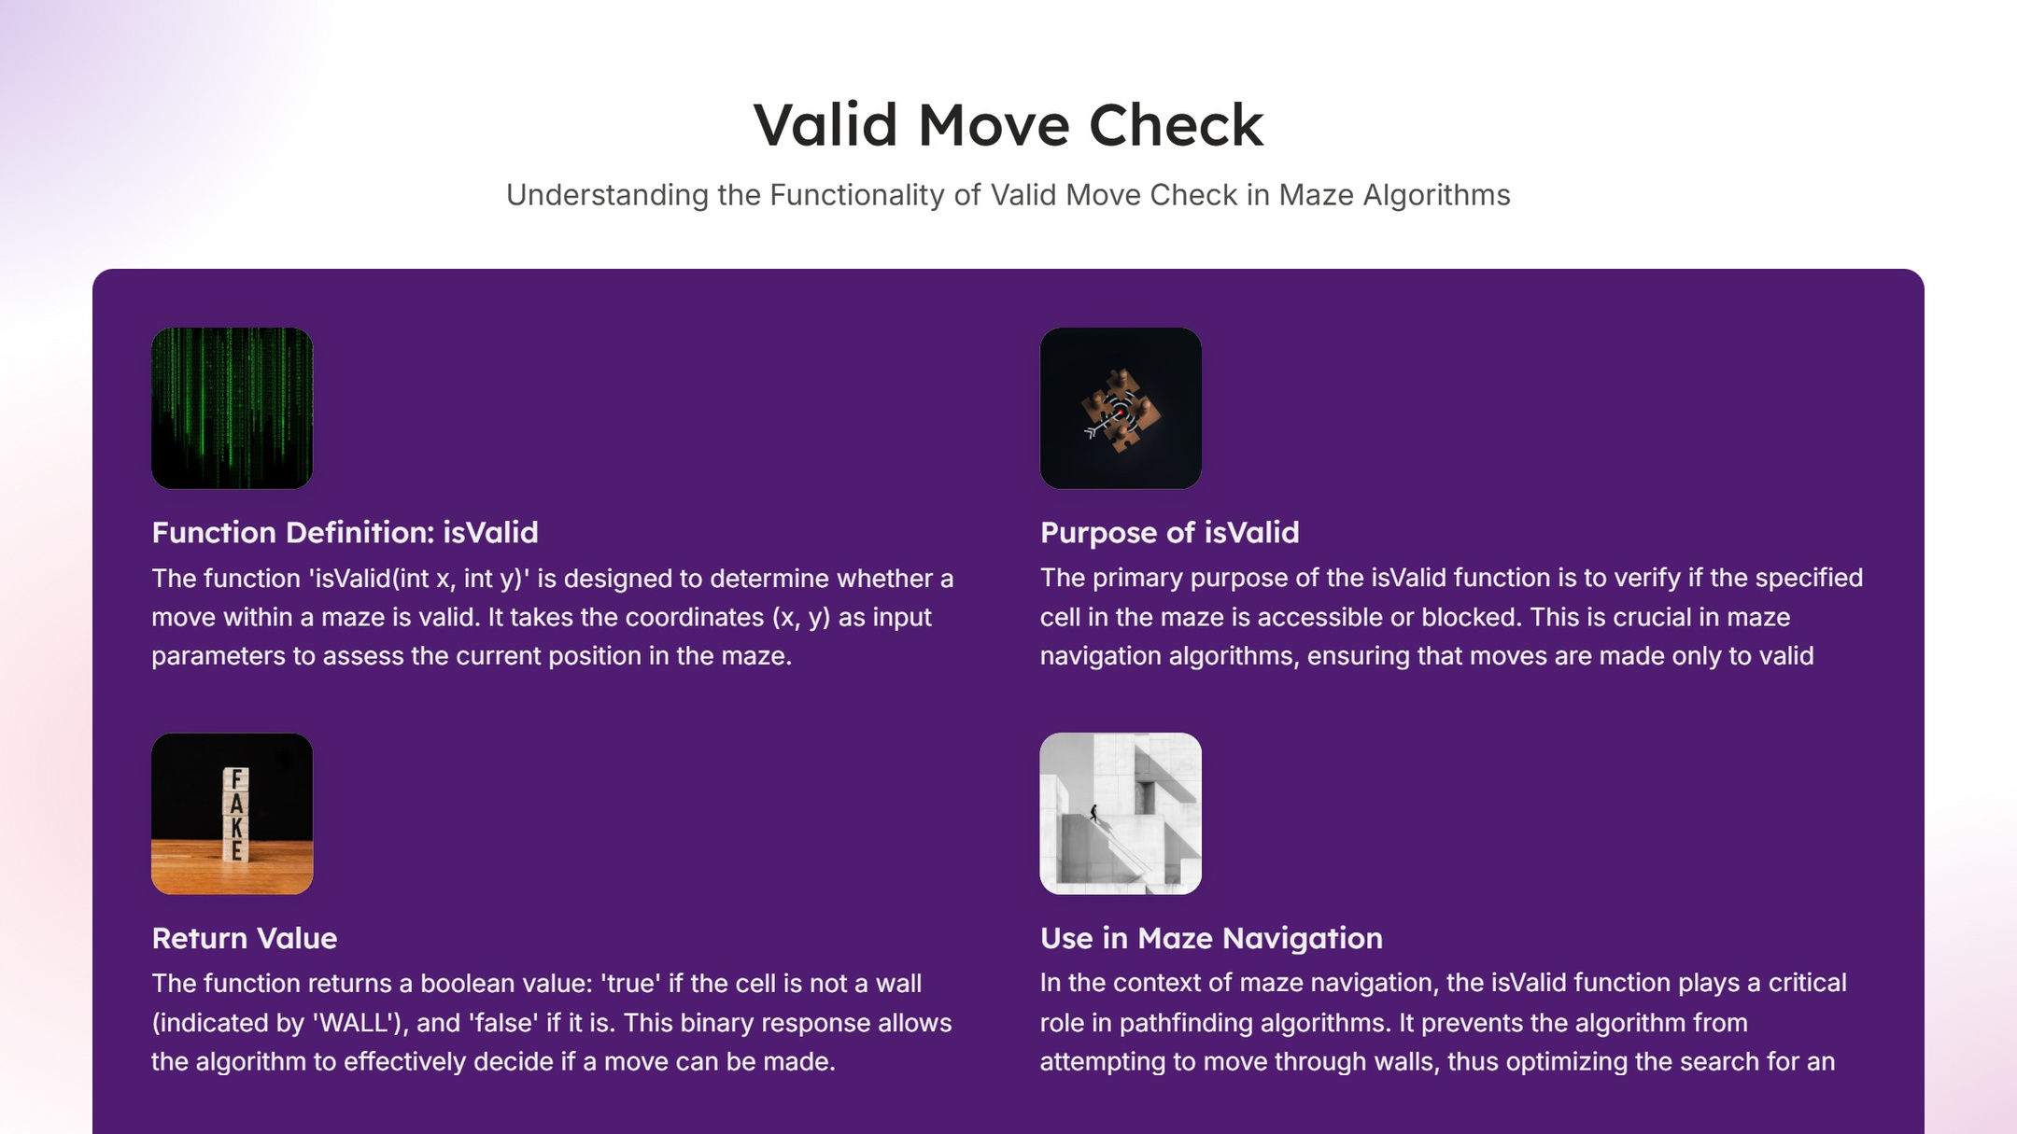

Slide 8
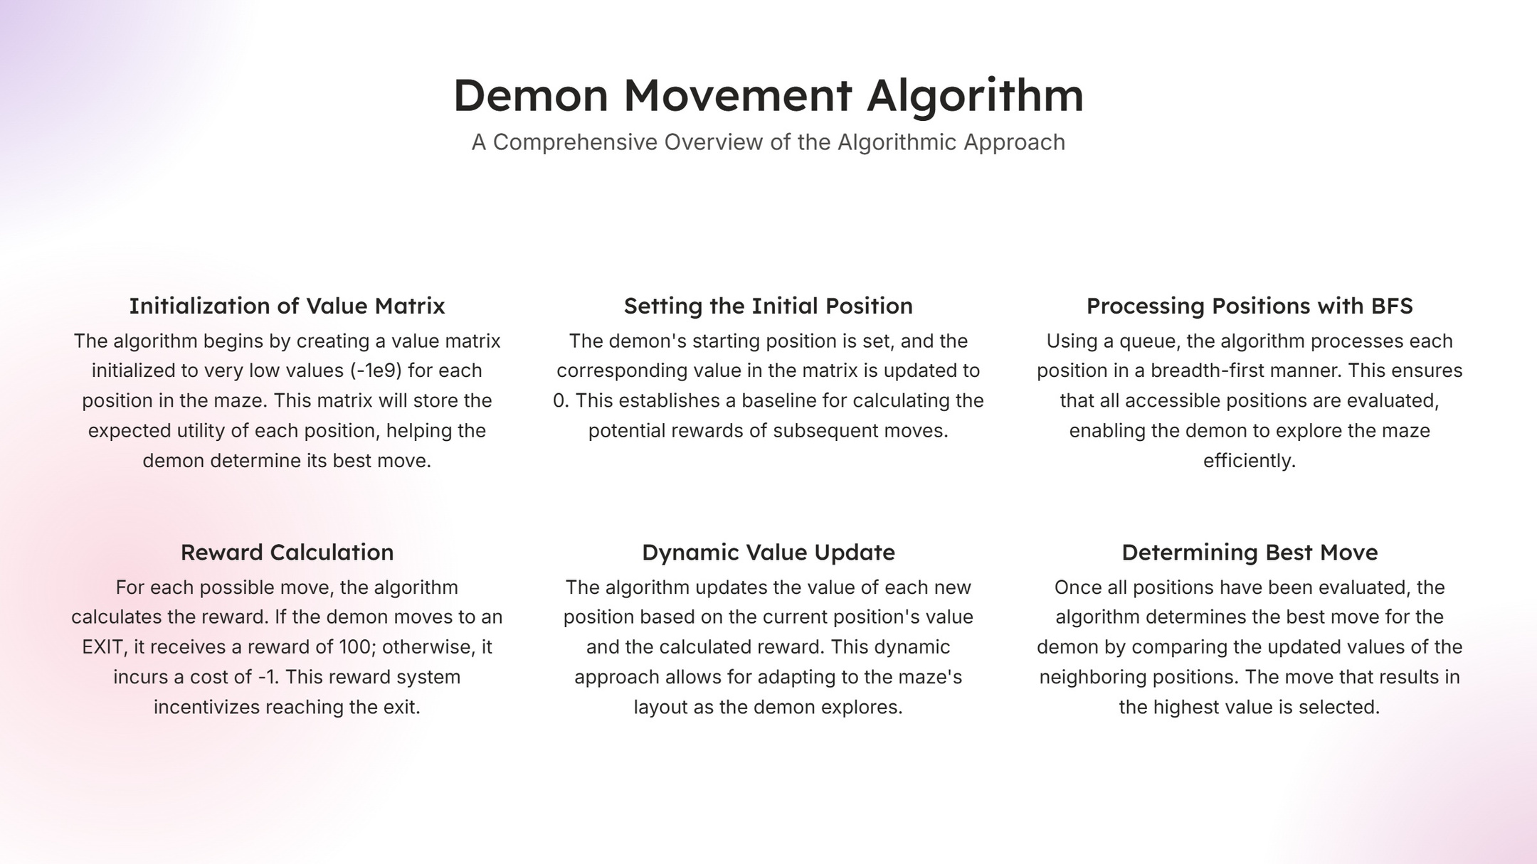

Slide 9
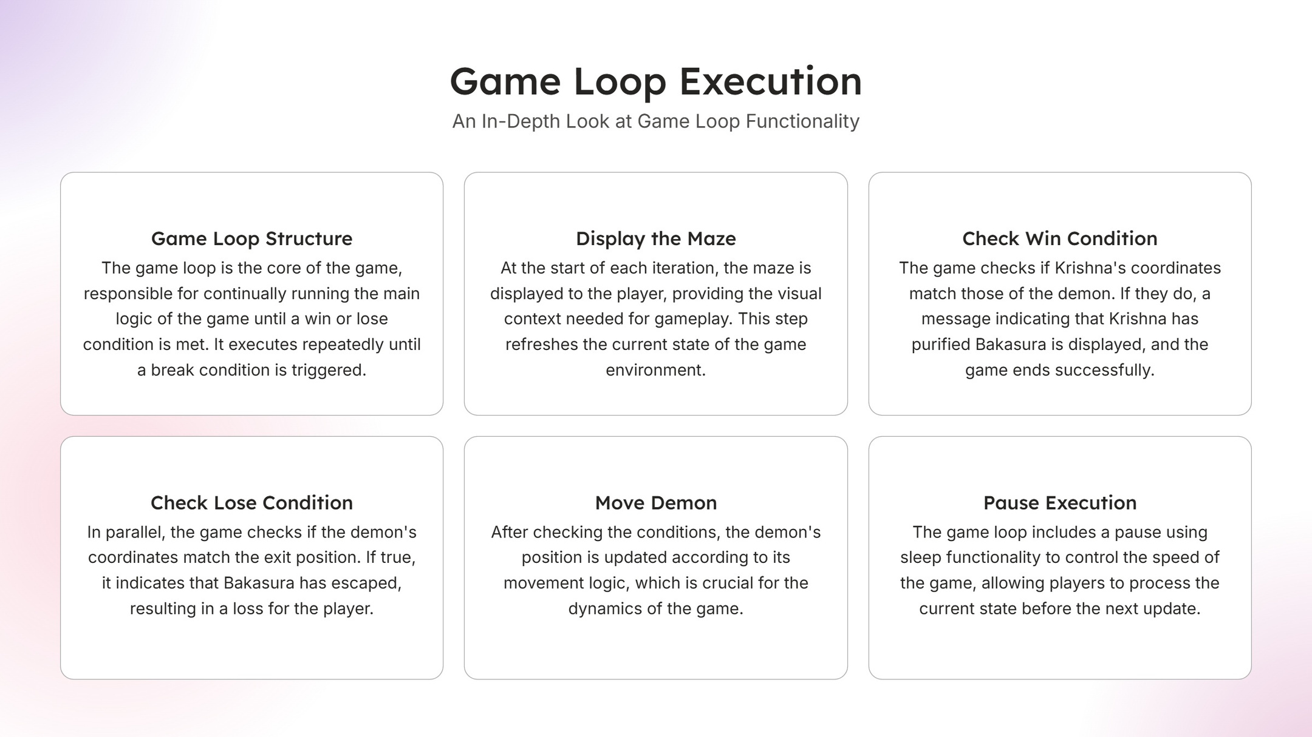

Slide 10

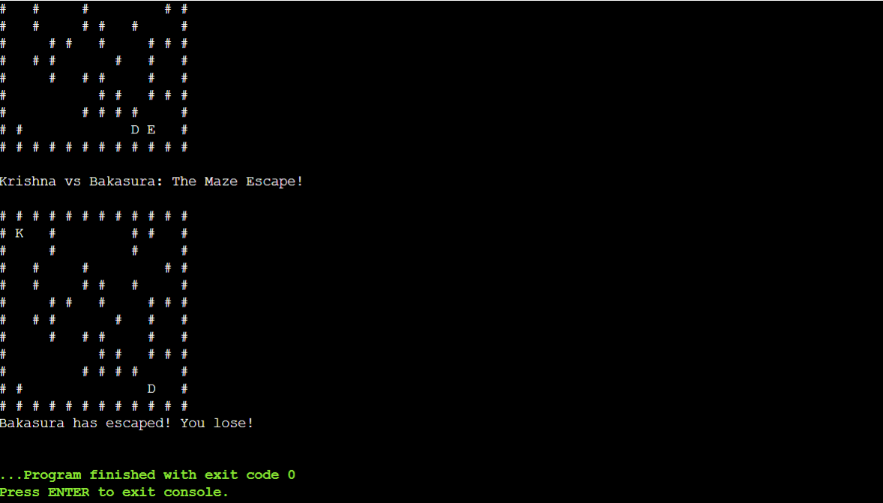
thecentrons/KrishnaVSBakasura
https://www.onlinegdb.com/fork/0jtQ1U9zT

